Slide 1
Final presentation
By Pranit Gore & Aditya Mane
Team Name: Team Zero Gravity
Team ID: PNC-50

Slide 2
Recap of previous week
The EEG signal was successfully segmented and annotated across five seizure zones: Z (healthy), O (non-seizure outside epileptogenic zone), N (non-seizure from epileptogenic zone), F (pre-seizure), and S (seizure).
Preprocessing was finalized with filtering, normalization, and windowing of signals.
13 statistical and spectral features were extracted from each EEG segment to capture core neural dynamics.
ML models like Random Forest, SVM, Logistic Regression, and XGBoost were trained on binary and multiclass tasks.
A deep learning-based CNN-LSTM hybrid model was designed for richer temporal learning.
Three functional modules were developed in Streamlit for: STFT Visualization, FFT Analysis, and Seizure Prediction.

Slide 3
Week 4 objectives
Finalize all five modeling methods including newly introduced wavelet-based extraction.
Execute 9 comparative modeling experiments across binary and multiclass setups.
Evaluate each model using 8 robust performance metrics like Accuracy, F1 Score, MCC, and AUC–ROC.
Integrate all results into an interactive Power BI dashboard tailored for neurologists.
Finalize the internship report, research paper draft, and set the direction for deployment.

Slide 4
Modeling methods summary
This slide explains the five methods implemented for seizure detection:
Classical ML models including RF, SVM, Logistic Regression, KNN, XGBoost.
Deep learning using CNN and Bi-LSTM for feature extraction and sequence learning.
A hybrid CNN–LSTM–Random Forest model that merges learned features with ensemble prediction.
A new wavelet-based method that extracts time-frequency signal characteristics using Lyapunov Exponent features and STFT metrics. All models were trained using 12 features and evaluated across 9 different binary configurations. Wavelet Lyapunov experiments were specifically conducted for Z vs O vs N vs F vs S, F vs Others, and S vs Others setups, contributing significantly to early detection of pre-ictal and ictal patterns.

Slide 5
Comparative experiments
We conducted the following 9 experiments using Bonn Dataset:
Z vs S
ZO vs S
N vs All, O vs All, F vs All, S vs All, Z vs All
ZO vs NF vs S
Multiclass Classification (Z, O, N, F, S) Each model was evaluated using 8 metrics: Accuracy, Precision, Recall, F1 Score, AUC–ROC, MCC, Cohen's Kappa, and Specificity. Additional wavelet-based experiments focused on key configurations such as F vs Others and S vs Others, which showed improved sensitivity in seizure-relevant zones. The multiclass Wavelet Lyapunov model helped visualize inter-zone transitions. The best model was later integrated into Power BI.

Slide 6
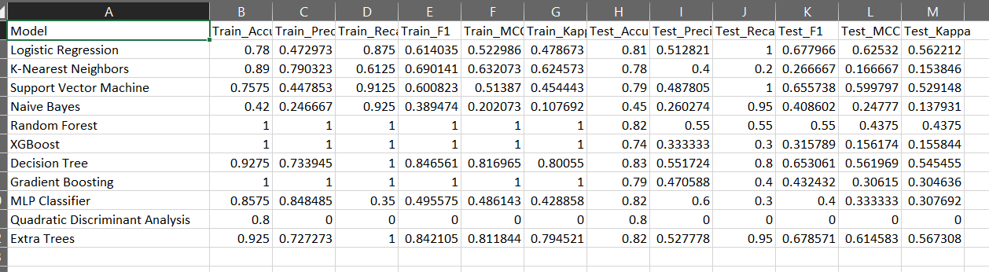
Wavelet Lyapunov output f vs others

Slide 7
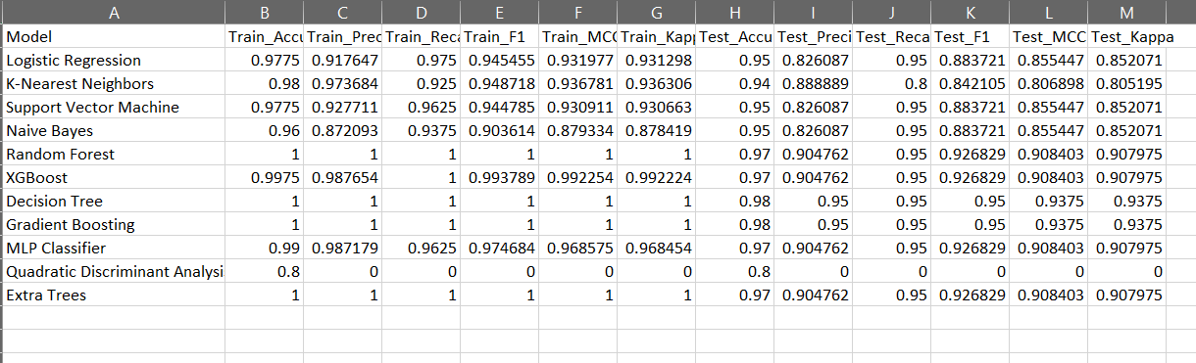
Wavelet Lyapunov output s vs others

Slide 8
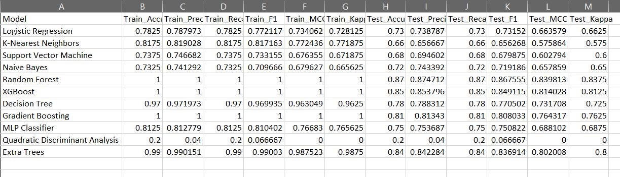
Wavelet Lyapunov output z vs o vs n vs f vs s

Slide 9
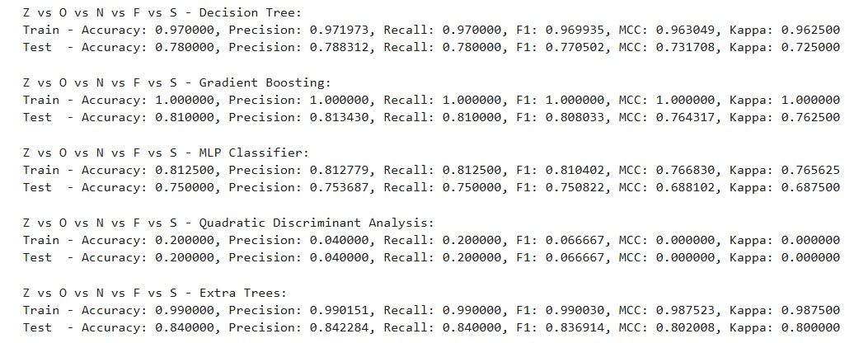
Comparison model outputs (1/2)

Slide 10
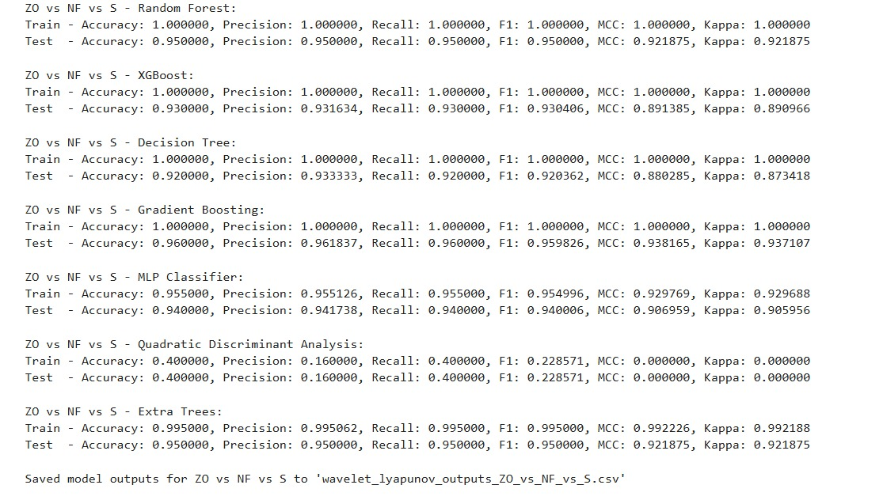
Comparison model outputs (2/2)

Slide 11
Streamlit application interface
Three independent modules were deployed:
STFT Visualizer allows uploading of CSV EEG files and comparing STFT plots across channels and patients.
FFT Visualizer plots the amplitude–frequency spectrum of two selected channels, highlights peak frequency and dominant band.
Seizure Predictor lets users upload processed EEG segments, select zone-wise models (Z vs S, ZO vs S), and visualize results including STFT, FFT, band power plots, and prediction confidence. Each app is modular, fast, and user-friendly.

Slide 12
Power bi dashboard integration
A separate Power BI dashboard was created for clinical usage.
It contains three tabs: STFT Tab, FFT & Frequency Tab, Seizure Class Summary Tab.
Users can select channels, view prediction scores, explore dominant bands, or examine band power distribution.
All 9 experiment results and model performance metrics are visualized using cards, charts, and tables.
Designed to support neurologists in interpreting EEG-based predictions

Slide 13
Innovations and highlights
We expanded modeling to five techniques and validated them across nine configurations.
Introduced a clean interface for seizure detection via Streamlit and a clinical analytics dashboard using Power BI.
Added early seizure detection analysis using zone-wise risk profiling.
Integrated 13 handcrafted features with spectral analysis (FFT, STFT, Wavelets).
Achieved 95%+ performance in binary classifications like Z vs S and ZO vs S with strong generalization.
Leveraged wavelet transform-based Lyapunov features to improve sensitivity in pre-seizure (F) and seizure (S) states.
Included comparative heatmap-style tables across models to assist medical researchers in benchmarking model robustness.

Slide 14
Future roadmap
Finalize research paper and submit to IEEE Scopus-indexed journal post-wavelet results.
Integrate patient-wise correlation heatmaps and syndrome-specific filtering.
Add temporal tracking of predictions for pre-seizure zone flagging.
Consult neurologists to evaluate clinical usability and minimize false positives.
Prepare for live demo at PuneCon 2025 and initiate pilot deployment for hospitals.

Slide 15
acknowledgements
We sincerely thank:
Dr T. Mangayarkarasi for mentorship and guidance.
IEEE EBMS Pune Chapter for organizing this research-oritented program.
Our HOD (Dr. Punam Raskar) and neurology collaborators for reviewing the system for clinical feedback
Each other, for building this system from scratch and achieving deployment readiness.

Slide 16
Thank you!
Links for Accessing our system:
Streamlit App:
1. FFT Visualization: https://fft-visualization.streamlit.app/
2. STFT Visualization: https://stft-visualization.streamlit.app/
3. Seizure Predictor: https://seizure-predictor.streamlit.app/
Github Repo: https://github.com/PRANIT0605/EEG_Epilepsy_Prediction
Contact:
Aditya Mane: adityamane1402@gmail.com
Pranit Gore: pranitgore05@gmail.com

